Slide 1
Praxyk
October 7, 2015
Accessible Machine Learning
The Praxyk Group

Slide 2
Members
John Allard (Product Owner)
Michael Vincent
Nick Church
Nick Corgan (Scrum Master)
Ryan Coley
Nikita Sokolnikov

Slide 3
Project Concept
Implement the most popular machine-learning tools and offer access to their predictive capabilities as a service through a dedicated API. This abstracts the issue of designing and maintaining a custom ML framework away from the customer and makes the predictive power of ML more accessible, especially for small businesses and software developers.

Slide 4
User Stories
As a public-facing office worker, I want to be able to upload an image and receive a transcription of the image’s text (OCR) as a string for handwritten form processing.
As a sys-admin, I want to be able to upload from 1 to n generic messages and get a probabilistic prediction on whether or not the given message is spam so I can manage incoming threats quickly and accurately.
As a developer I want to be able to use a portable web-api so I can access these services from many different locations without having to worry about dependencies and training data.
As a software developer I want higher-level bindings to the Praxyk API in my favorite languages (like python, javascript, and c++) so that I can integrate Praxyk’s services into my existing codebases.
As a software developer, I want to be able to use an existing-model of a neural network as a template that I can then train with my own data to more accurately suit my specific prediction needs.
As a subscriber of Praxyk’s services, I want a website to be available to use the Praxyk services through a graphical environment, so I don’t have to touch any code if I don’t need to.
As a subscriber of Praxyk’s services, I want to be able to see transaction and payment history through an organized, graphical user dashboard so that I can view my previous requests and billing statements for those requests.

Slide 5
User Stories cont.
As a subscriber of Praxyk’s services, I want to pay a monthly bill for these services that accumulate cost on a transactional basis.
As a subscriber of Praxyk’s services, I want to be able to pay more for faster results so I can adjust my costs to fit my demand on a case by case basis.
As a software developer, I want a group of specialists to handle training and management of the most popular machine learning models, so I only need to know what I want to do with the service, not how it works.
As a software developer, I want to be able to create, modify, and train neural networks that are always accessible without the hassle of writing code and managing raw infrastructure.
As a subscriber of Praxyk’s services, I want push notifications on my desktop when my request is done processing, so that I don’t have to monitor jobs I have sent to Praxyk’s API and are happening in the background.
As a developer, I want to be able to access complete documentation for the API through the website (including tutorials).
As a tester, I need to be able to do software builds and run regression tests to ensure the quality of the services.

Slide 6
MoSCoW and Planning Poker
Story | Must Have | Should Have | Could Have | Won't Have | Low Points | High Points
OCR |  | 1 |  |  | 2 | 3
Spam detection |  | 1 |  |  | 4 | 5
Web API | 1 |  |  |  | 5 | 6
Client bindings |  |  | 1 |  | 2 | 3
NN templates |  |  | 1 |  | 6 | 7
Praxyk website | 1 |  |  |  | 4 | 5
Payment GUI |  |  | 1 |  | 2 | 3
Billing |  |  | 1 |  | 3 | 4
Pay-for-perf |  |  | 1 |  | 6 | 6
Train ML models | 1 |  |  |  | 7 | 8
User-trainable ML | 1 |  |  |  | 7 | 8
Push notifications |  |  | 1 |  | 1 | 1
Online Docs. | 1 |  |  |  | 3 | 4
DV and TDD | 1 |  |  |  | 4 | 5
Totals | 6 | 2 | 6 | 0 | 53 | 64

Slide 7
Sprint Structure
Story # | Sprint 1 | Sprint 2 | Sprint 3
1 | OCR
2 |  | Spam detection
3 | Web API
4 |  |  | Client bindings
5 |  |  | NN templates
6 | Praxyk website
7 |  | Payment GUI
8 |  |  | Billing
9 |  |  | Pay-for-perf
10 | Train ML models
11 |  | User-trainable ML
12 |  |  | Push notifications
13 |  | Online Docs.
14 | DV and TDD | DV and TDD | DV and TDD
Totals | 5 | 6 | 6

Slide 8
Project Release Architecture
-Web API that processes requests and returns a result calculated by our machine learning tools
-POD (prediction on demand)
-TLP (templated learning platform)
-Nice graphical website and billing management

Slide 9
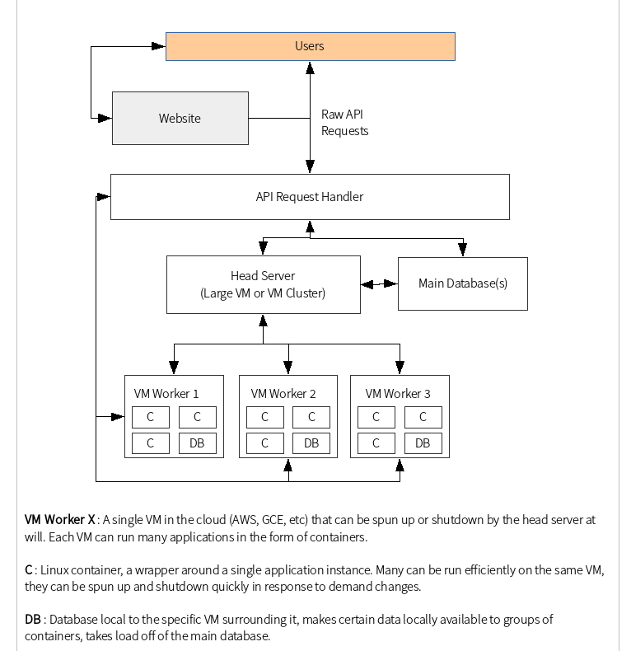
Project Release Architecture

Slide 10
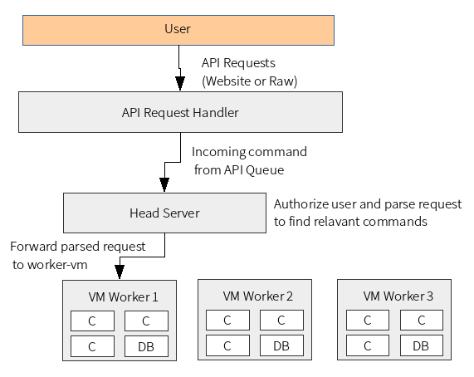
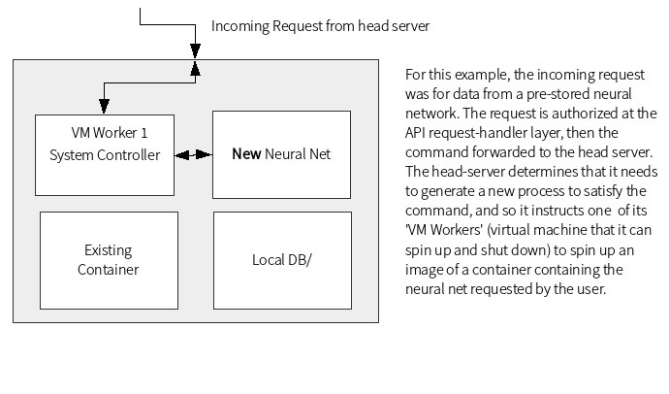
Project Release Architecture
e

Slide 11
Challenges/Risks
Potentially massive?
Issues with queueing and containerization
Entire chain of communication has to be perfect
Neural nets and machine learning software in general has to be well-behaved
Back end MUST scale properly
Letting users train their own software could be potentially difficult
Development Costs
Payment Handling
Handling very large datasets from the user.

Slide 12
Technologies Used
Programming languages: C++, Python, Javascript
Machine learning libraries: FANN, Tesseract OCR, mlPack
Multiple IaaS Providers : AWS, Digital Ocean, GCE
Docker containers to manage software development and deployment.
MySQL for SQL and Redis for NoSQL
Slack for group chat, Github for source + Wiki
Flask + nginx for API server.

